Slide 1

Diabetes and Pregnancy and Machine learning! Oh, My!
By Andrea Fagerman

Slide 2

Diabetes Introduction
Diabetes is a chronic metabolic disease
Type 1: the pancreas not producing enough insulin
Type 2: the body can’t use the insulin it produces effectively
Gestational: do you know??
Diabetes outcomes for women are worse than men
Most common complication from diabetes is heart disease
Diabetes increases the chance of heart disease ~4x for women compared to ~2x for men
Don’t get me started on the abysmal health outcomes for that for women compared to men
Women have higher risk of getting other related complications too
Blindness, kidney disease, depression

Slide 3

Diabetes Introduction: Women
According to the CDC, men have slightly higher rates of diabetes than women, but women have slightly higher rates of going undiagnosed than men.
Sex | Diagnosed diabetes Percentage (95% CI) | Undiagnosed diabetes Percentage (95% CI) | Total diabetes Percentage (95% CI)
Men | 12.6 (11.1-14.3) | 2.8 (2.0-3.9) | 15.4 (13.5 – 17.5)
Female | 10.2 (8.8-11.7) | 3.9 (2.7-5.5) | 14.1 (11.8-16.7)
According to some studies, women were diagnosed with diabetes 4.5 years later compared to men.

Slide 4

Gestational Diabetes
Type of diabetes that can develop during pregnancy for people who don’t already have diabetes.
Typically ends following delivery
Information is conflicted, but according to many sources, including American Diabetes Association, the causes of gestational diabetes are unknown.
An analysis of NIH funding shows that only 2% of its diabetes specific funding goes towards gestational diabetes research.
Gestational diabetes affects up to 10% of pregnancies in the United States
I don’t want to say it’s sexism, but it’s probably sexism.

Slide 5
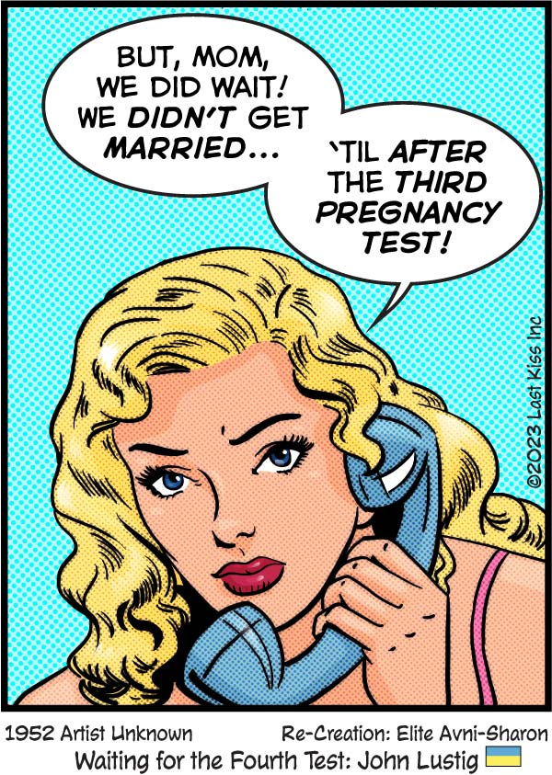
Gestational Diabetes Dataset
This data was collected from 2000 people at the Frankfurt Hospital in Germany
The eight features of the patients in this dataset are:
Number of pregnancies
Glucose level
Blood pressure
Skin thickness
Insulin level
Body mass index
Diabetes likelihood
Age

Slide 6


Random Forest Model
Random forest is a machine learning model that consists of decision trees
Random forest is an excellent choice for classification and high-dimensional data often found in the sciences
Another benefit is it handles imbalanced data well
Steps for random forest:
1. Data preparation
2. Data exploration/visualization
3. Split and train the model
4. Evaluate Model (accuracy, ROC-AUC, F1-score , etc)
5. Model prediction and interpretation

Slide 7

Gestational Diabetes Dataset Preparation
There was a lot of missing data in my dataset.
I replaced missing data with mean of its respective category.
I also created categories for BMI and age.

Slide 8
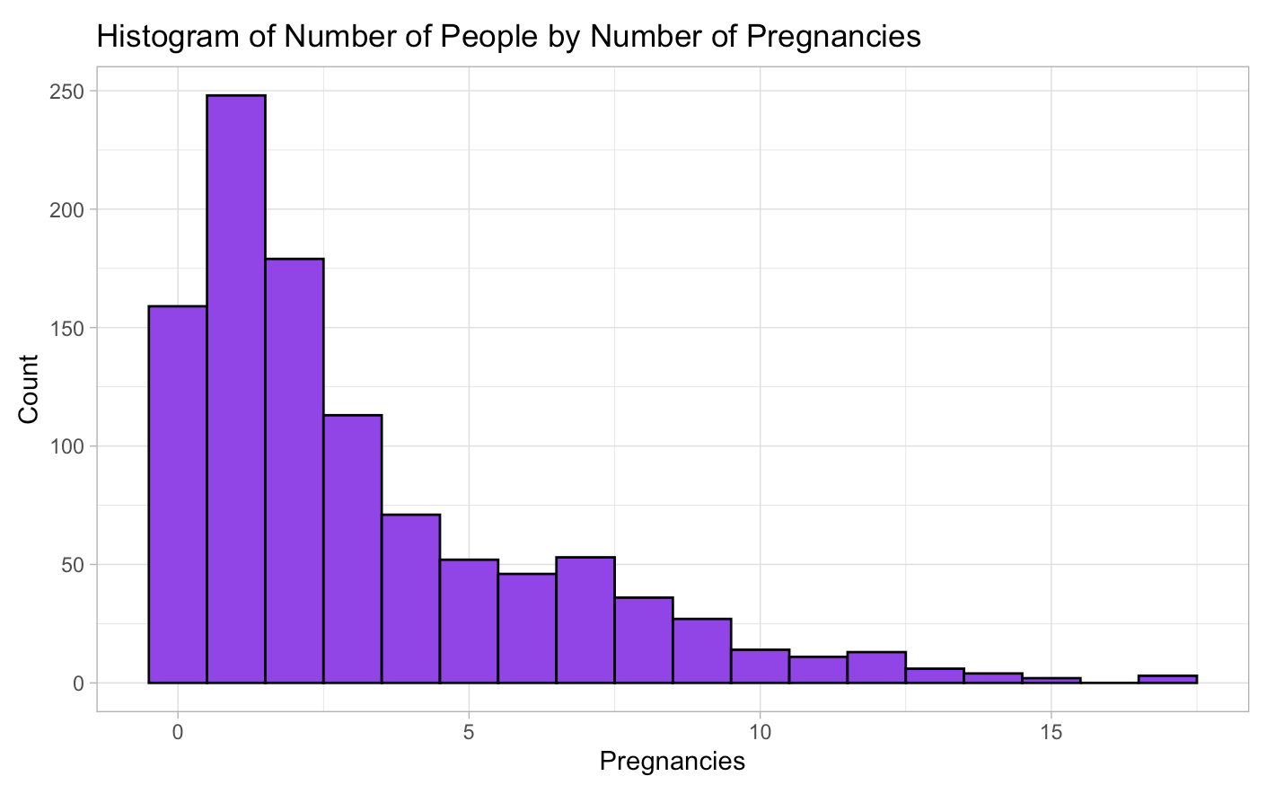
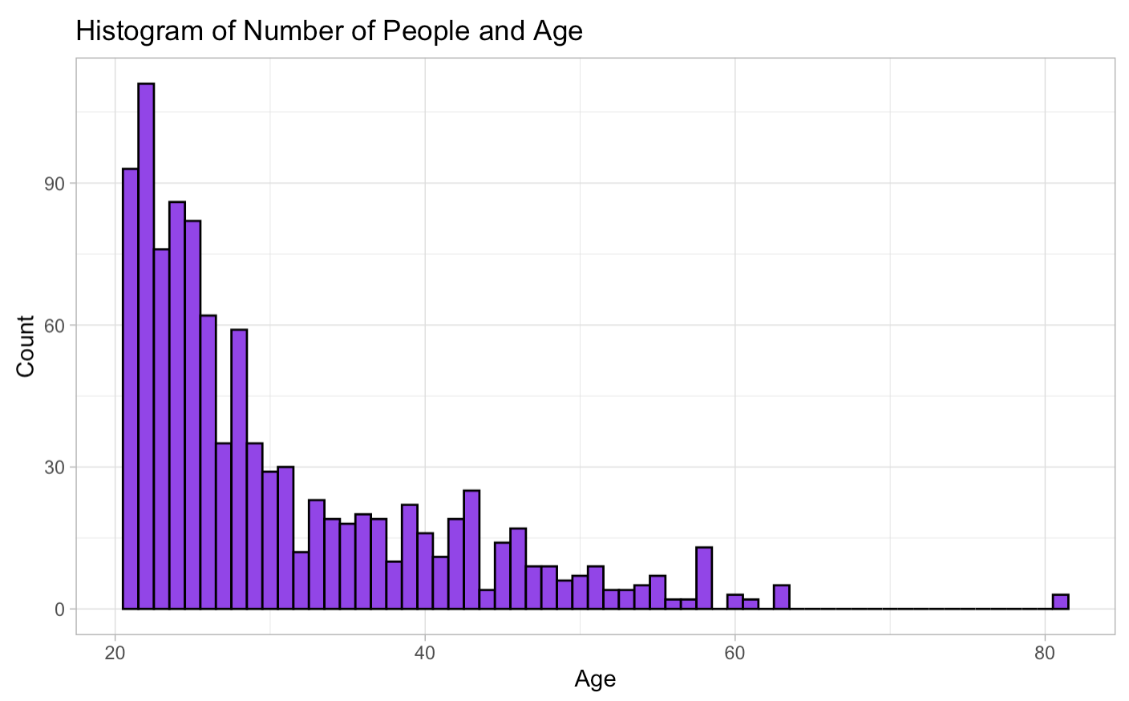
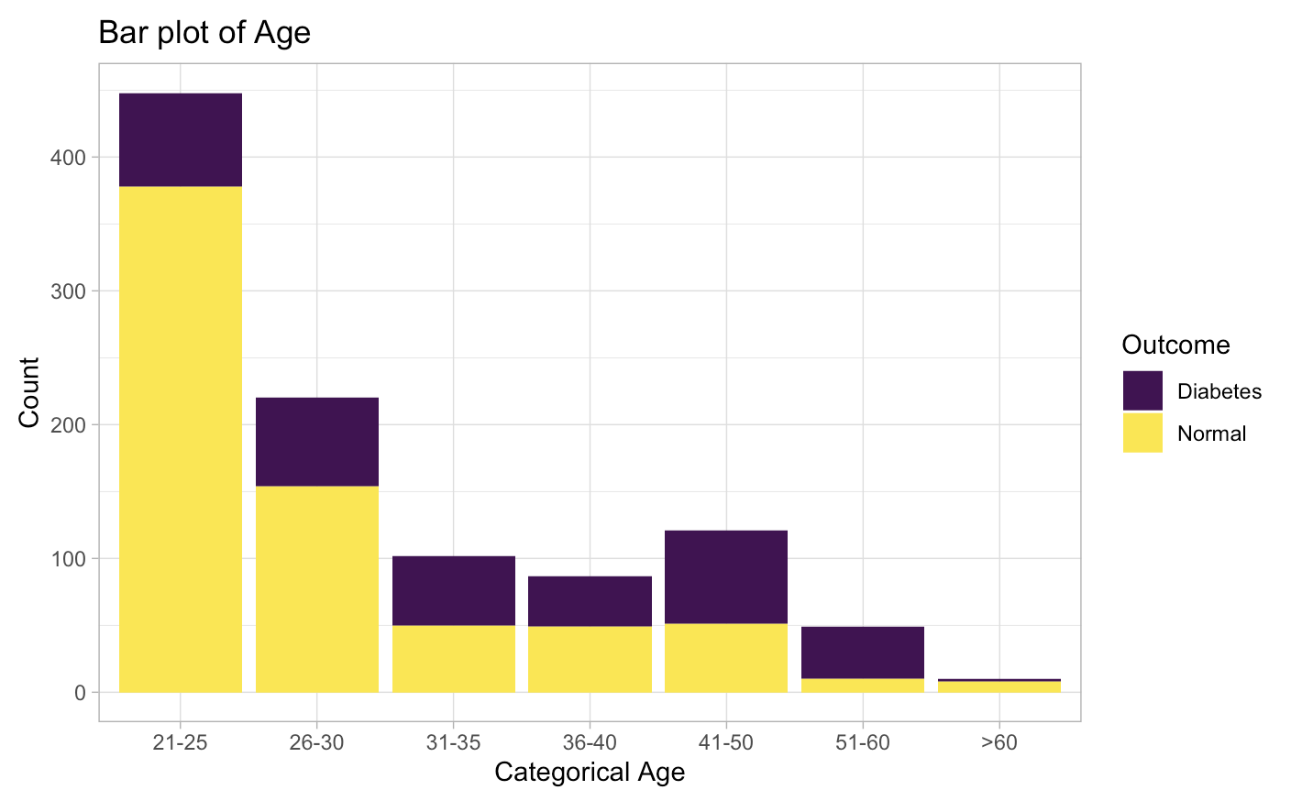
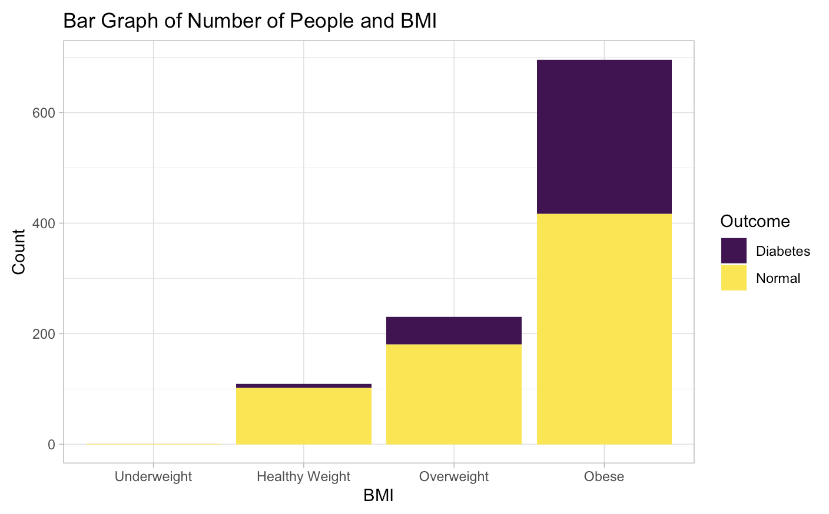
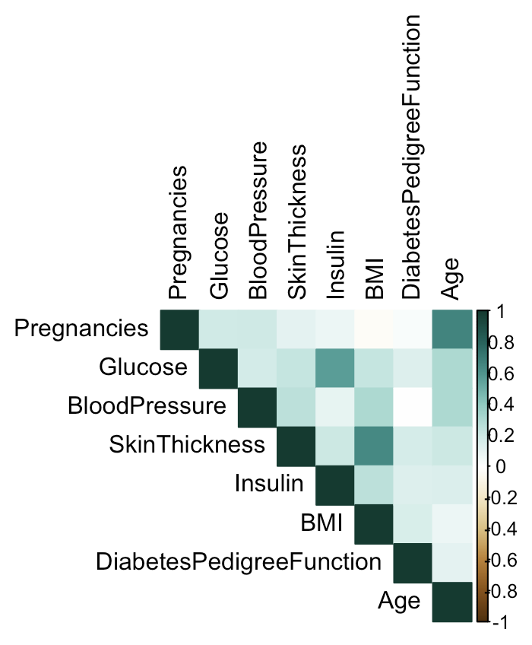
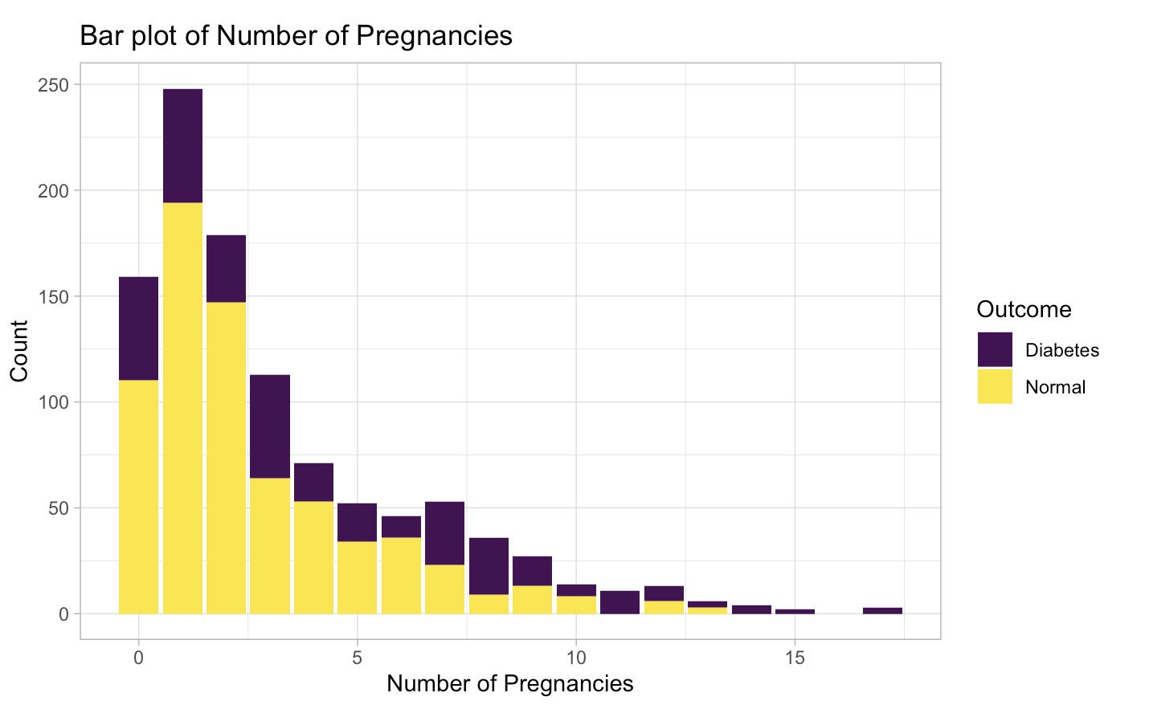
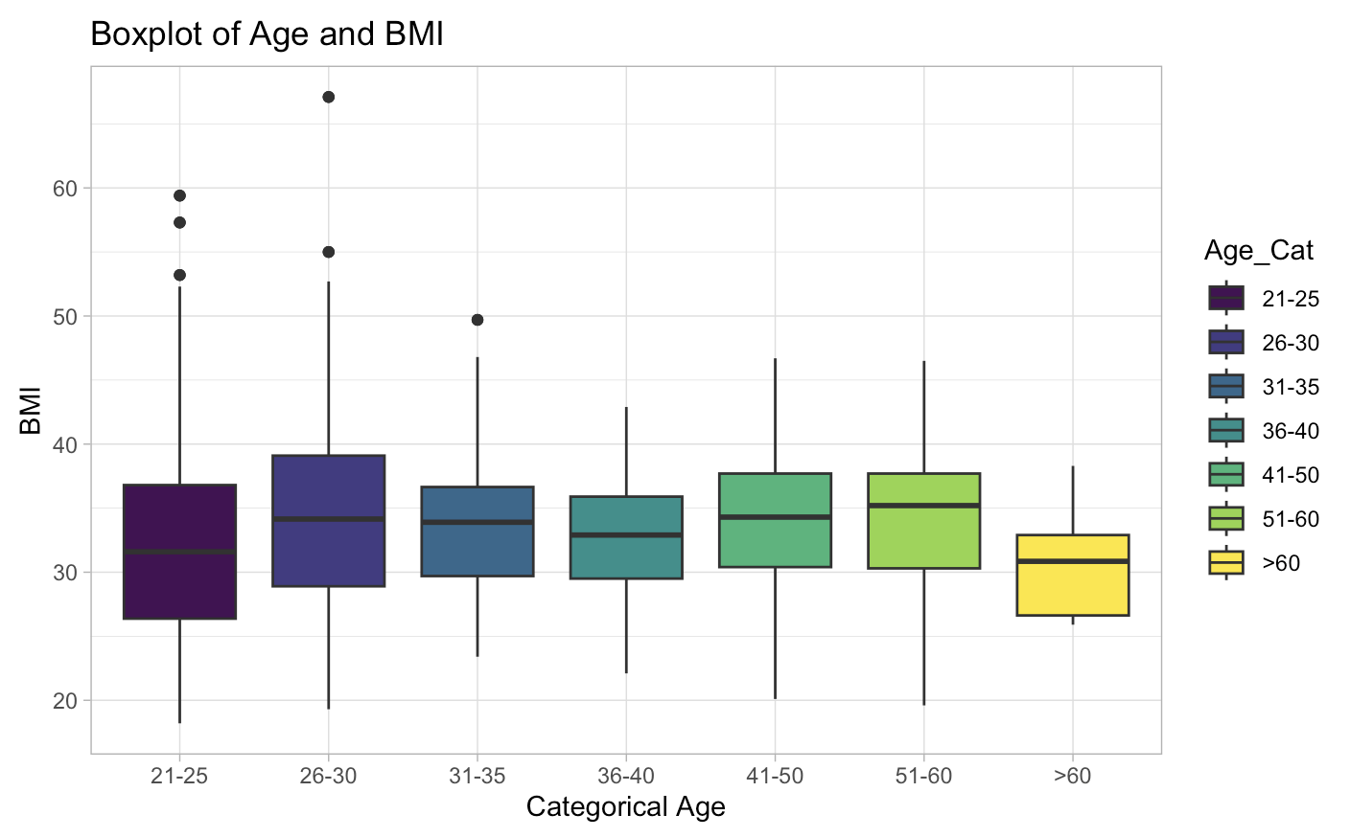

Data Exploration/Visualization

Slide 9

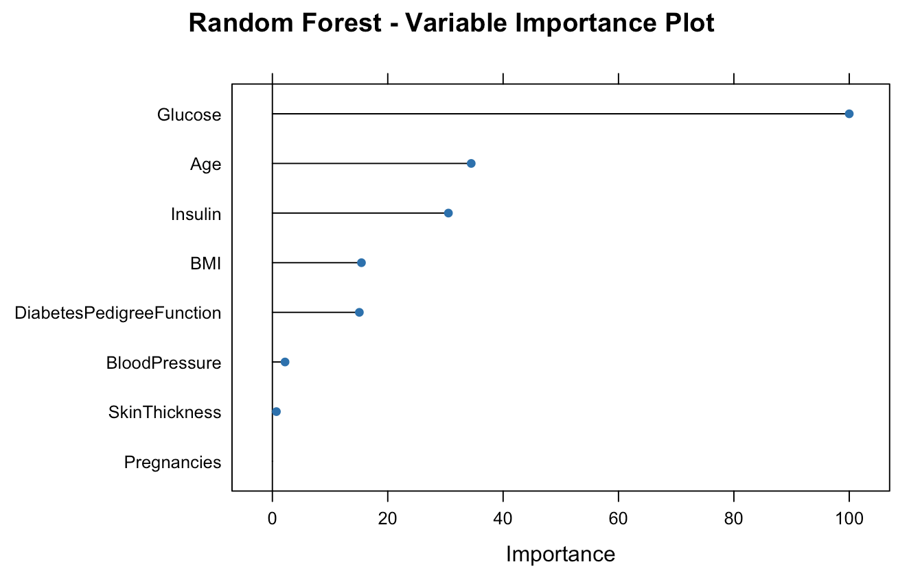
Splitting and Training Model*
* and one evaluation image
Since dataset so large, I used an 80/20 split
80% used for training and 20% used for testing
Set seed to a higher value so it could be more reproducible
I created a random forest model where the Outcome was the dependent variable and all others in the training segment were the independent variables

Slide 10
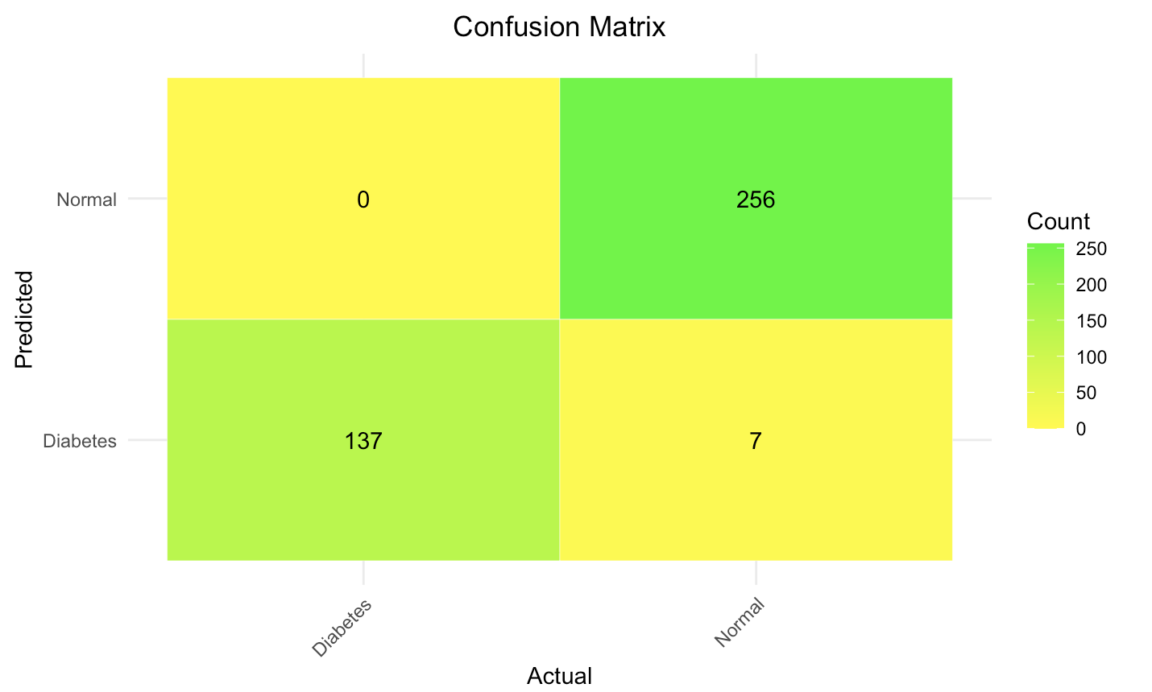
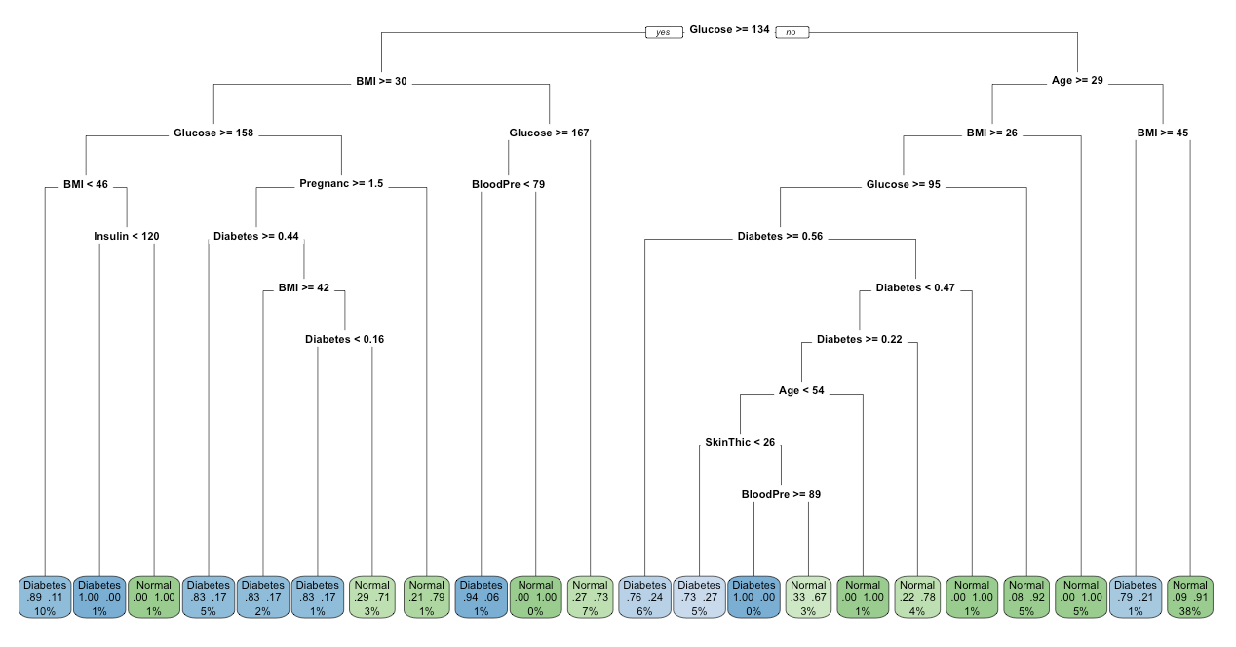
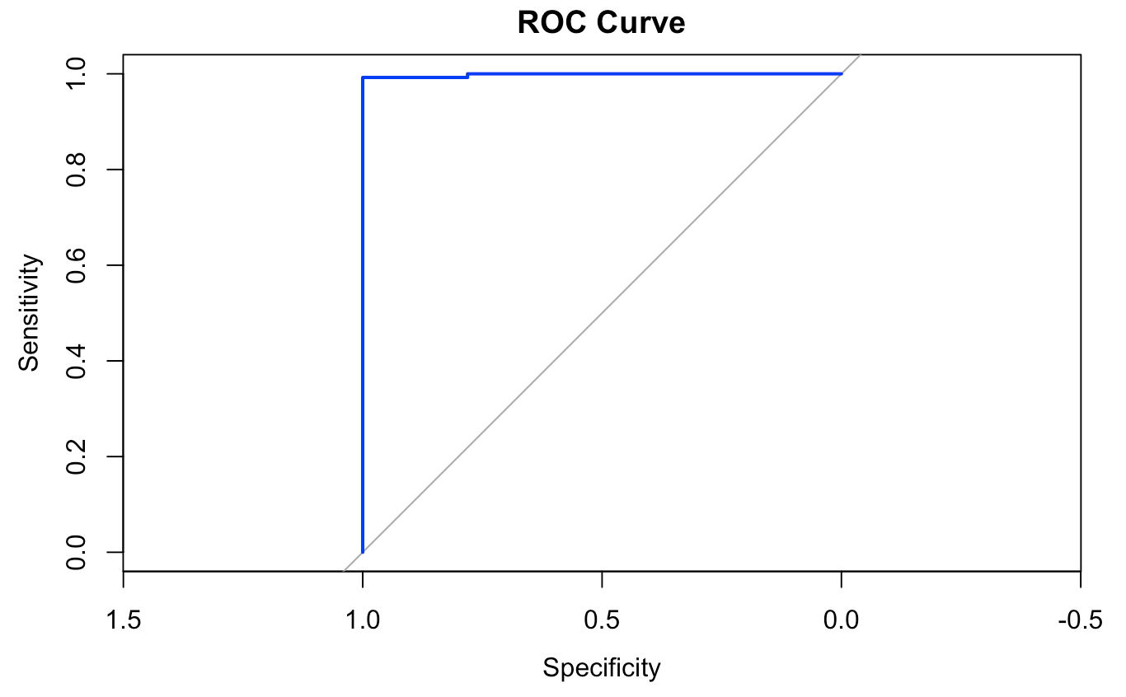
Evaluate Model
F1 Score: 0.975
Harmonic mean that uses precision and recall; it penalizes for big differences between precision; ranges from 0 to 1
ROC AUC: 0.998
The curve on the RUC map represents the true positive rate (sensitivity) against false positive rate (1 - specificity)
Sums up how well the model can perform and ranges from 0 to 1

Slide 11
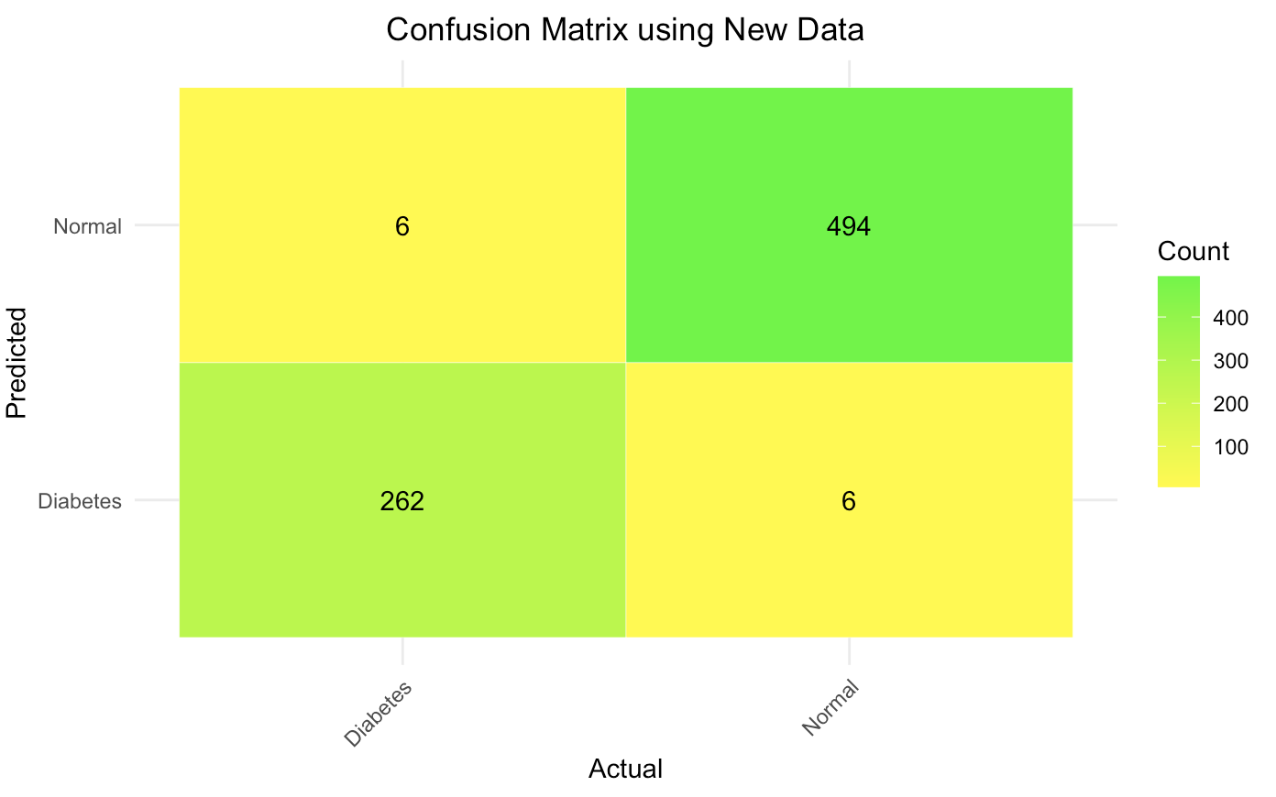

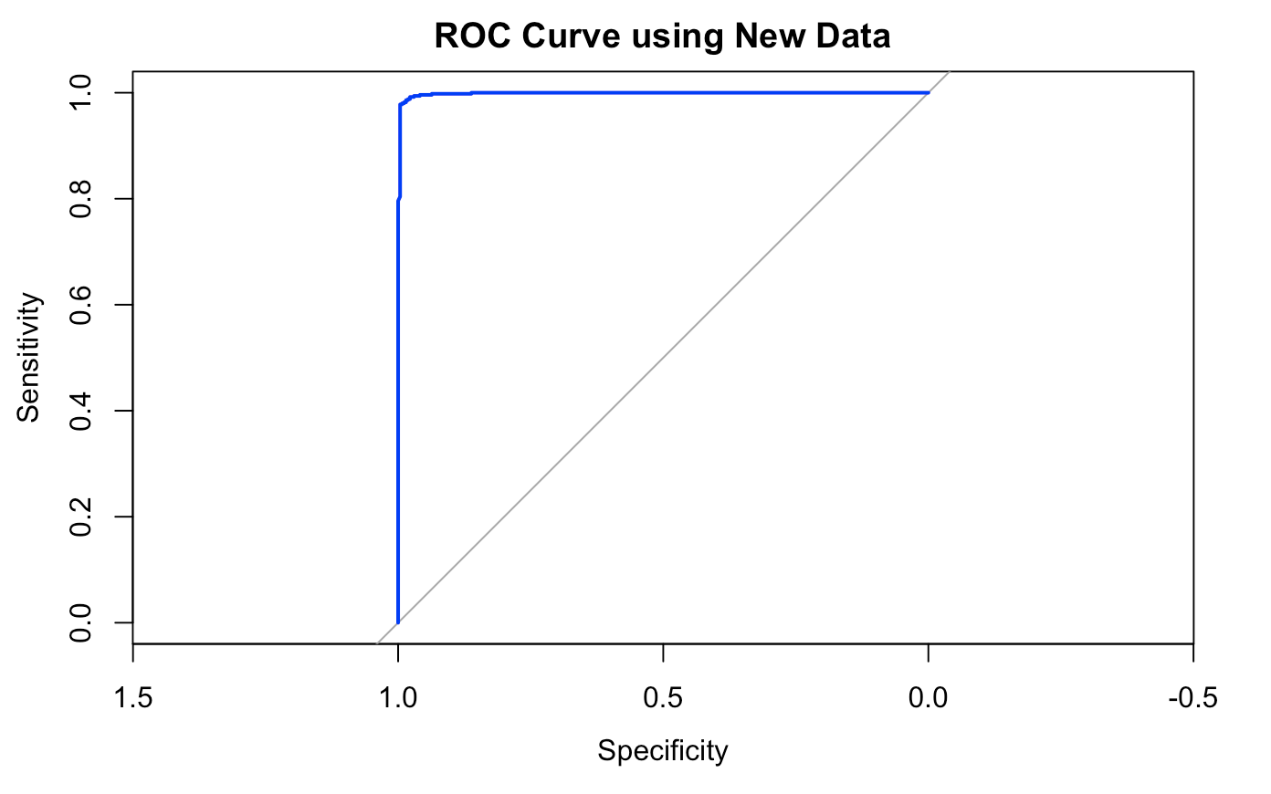
Model Prediction and Interpretation
Found similar data from National Institute of Diabetes and Digestive and Kidney Diseases for 768 females at least 21 of Pima Indian heritage.
Processed data and then used my model to predict outcomes.
F1 score: 0.978
ROC AUC: 0.999
My model showed to be highly effective at predicting new data’s outcomes.

Slide 12

The end.

Slide 13
References
https://www.cdc.gov/diabetes/basics/diabetes.html#:~:text=With%20diabetes%2C%20your%20body%20either,releases%20it%20into%20your%20bloodstream.
https://www.cdc.gov/diabetes/library/features/diabetes-and-women.html
https://www.mckinsey.com/mhi/our-insights/closing-the-womens-health-gap-a-1-trillion-dollar-opportunity-to-improve-lives-and-economies
https://www.thejdca.org/publications/report-library/archived-reports/2022-reports/nih-diabetes-research-funding-fy2021.html#:~:text=%24908%20Million%3A%20amount%20allocated%20by,80%25%20of%20the%20total%20budget.&text=%2419%20Million%3A%20amount%20allocated%20by,2%25%20of%20the%20entire%20budget.&text=The%20NIH%20funded%20zero%20Practical%20Cure%20projects%20in%202021.
https://diabetes.org/about-diabetes/gestational-diabetes
https://www.kaggle.com/datasets/uciml/pima-indians-diabetes-database/data
https://ieee-dataport.org/documents/type-2-diabetes-dataset

